Slide 1
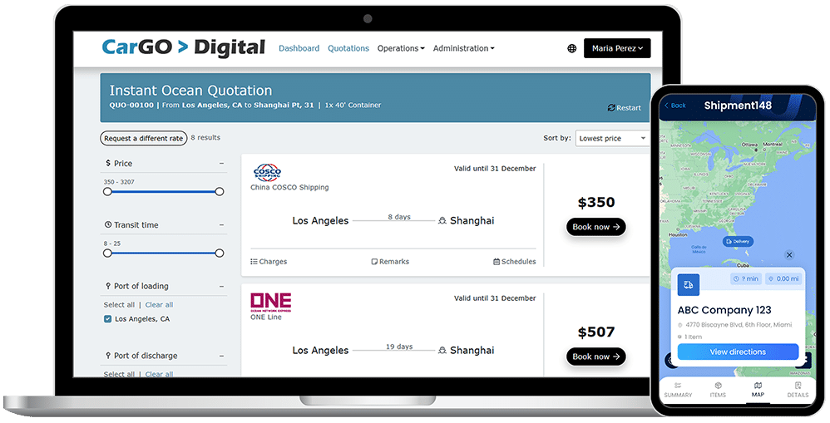
MOVING FREIGHT
FORWARD
The #1 Freight Management Platform for Logistics Service Providers

Slide 2






INDUSTRIES WE SERVE
FREIGHT FORWARDING
3PL
NVOCC
WAREHOUSE
COURIER
CUSTOMS BROKERAGE

Slide 3

UNIFIED SHIPPING & WAREHOUSING FOR SEAMLESS OPERATIONS​
Manage freight, warehousing, and distribution in a single platform, eliminating silos and inefficiencies.
MODULAR PLATFORM THAT SCALES WITH YOU​
Start with what you need and expand as your business grows.
​
EASY INTEGRATION WITH ANY THIRD-PARTY SYSTEM​
Connect effortlessly with ERPs, accounting software, e-commerce platforms, and more.​
GLOBAL, BEST-IN-CLASS CUSTOMER SUPPORT​
Wherever you operate, our world-class support team provides fast, expert assistance.
A CULTURE OF INNOVATION, EXCELLENCE, AND SERVICE​
We’re committed to continuous improvement, customer success, and delivering innovative solutions that move freight forward.
THE MAGAYA DIFFERENCE

Slide 4
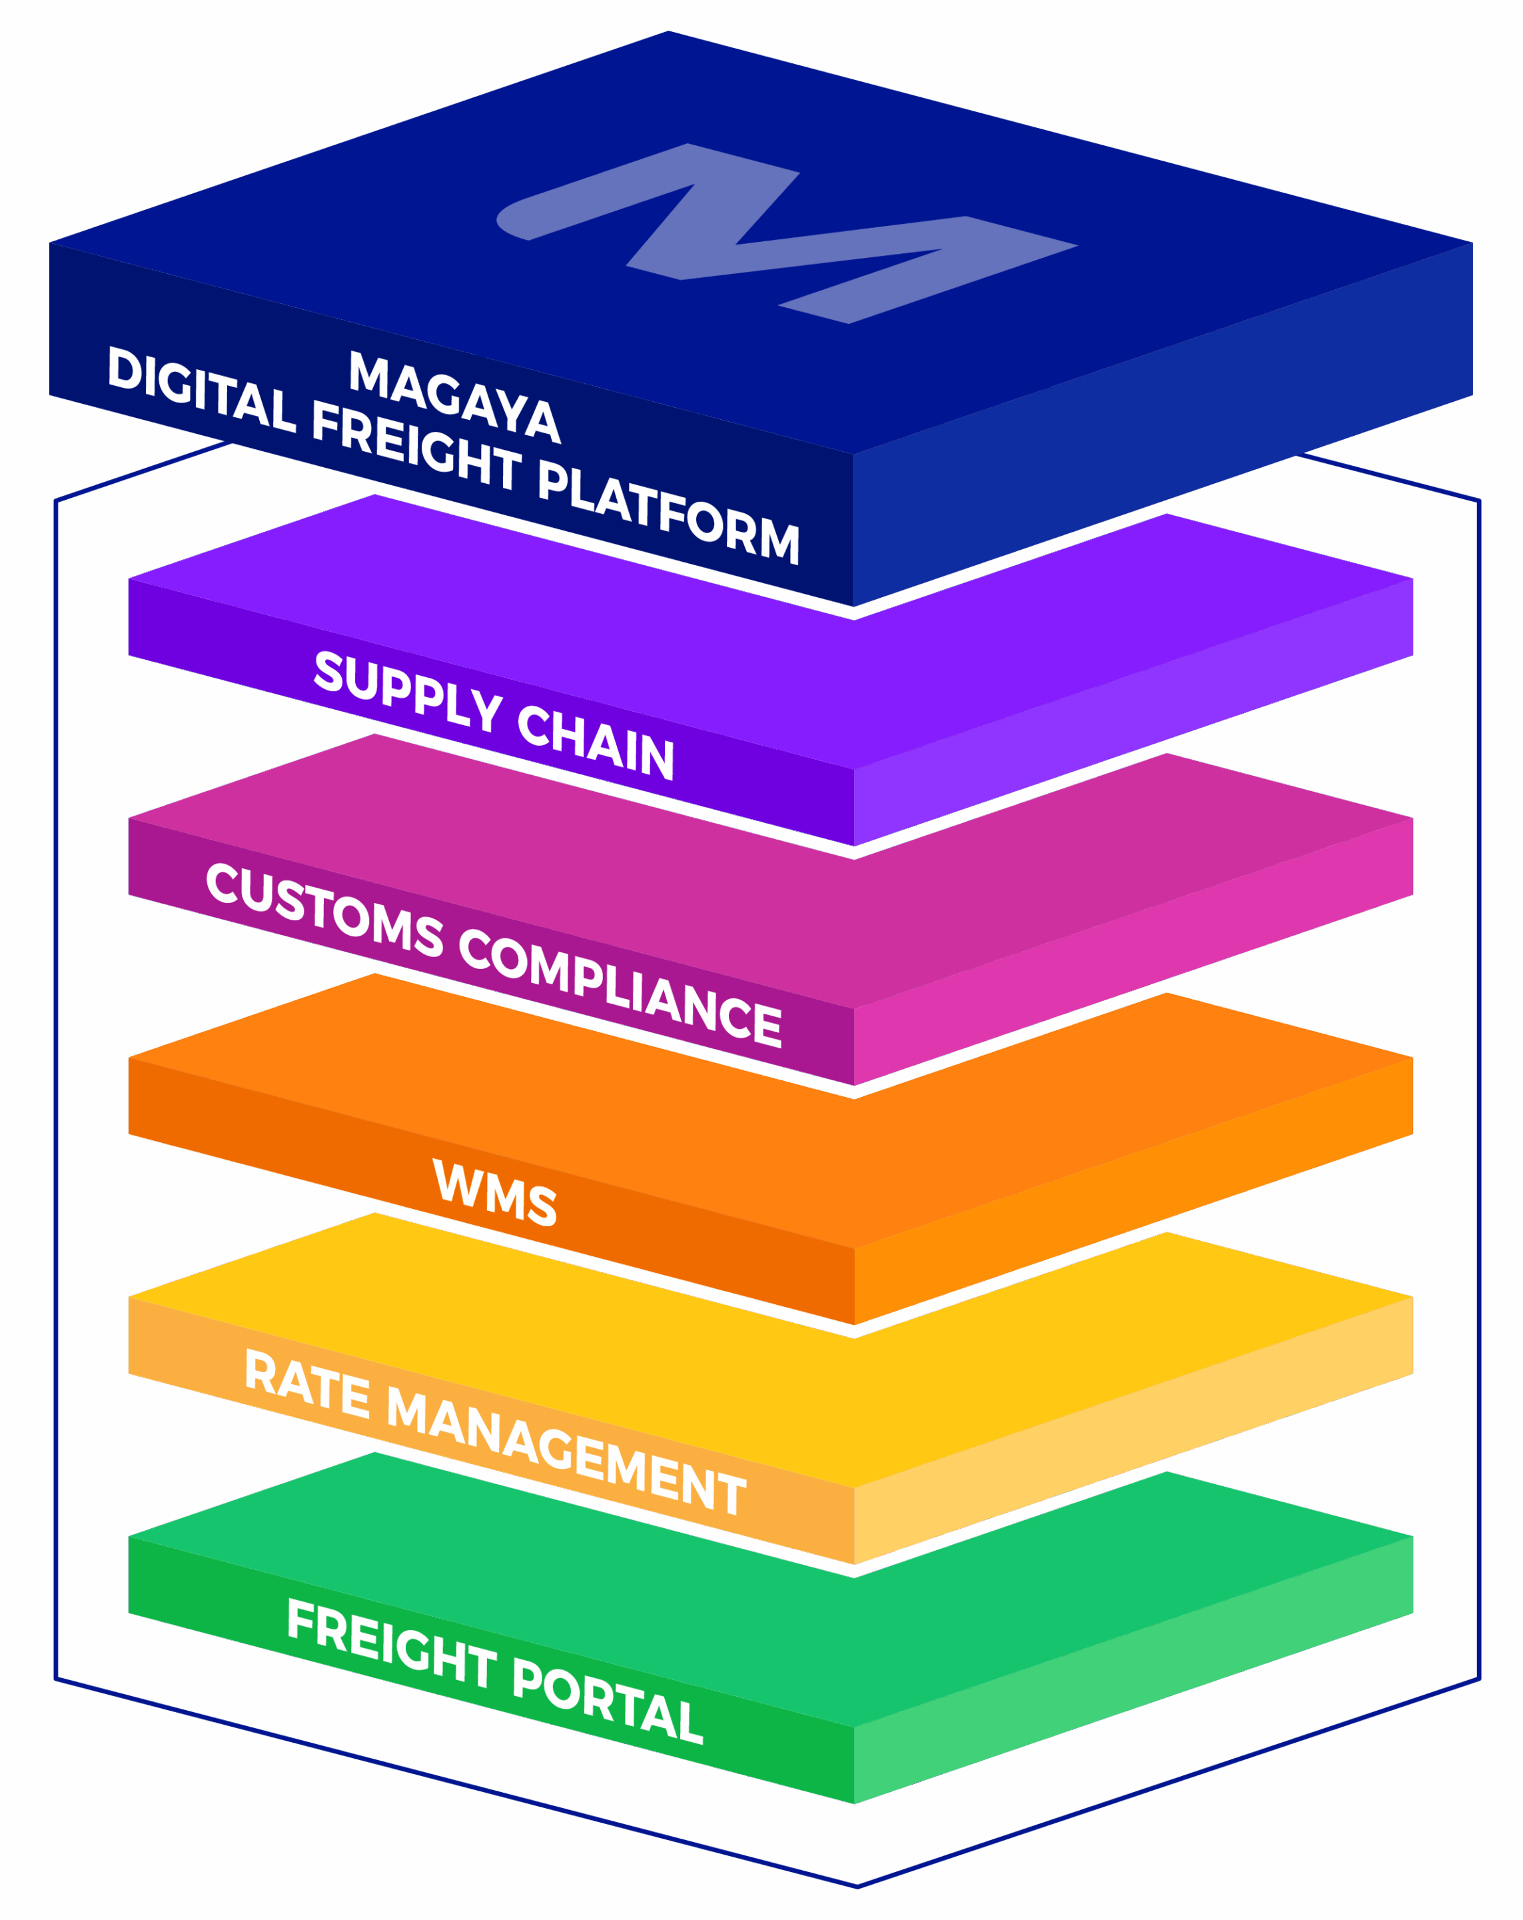
MAGAYA SUPPLY CHAIN Optimize Shipping and Warehousing Operations
MAGAYA
DIGITAL FREIGHT
PLATFORM
THE #1 FREIGHT MANAGEMENT PLATFORM FOR LOGISTICS SERVICE PROVIDERS
MAGAYA CUSTOMS COMPLIANCE Stay Compliant
MAGAYA WMS Streamline Your Warehouse
MAGAYA RATE MANAGEMENT Quote Faster Win More Business
MAGAYA DIGITAL FREIGHT PORTAL Digitize the Customer Experience
MAGAYA CONNECT Easily Connect Any System

Slide 5



TECHNOLOGY WITHOUT COMPROMISES
The Magaya Digital Freight Platform delivers flexible, interoperable, modular, cloud-based solutions that can be used together as an integrated logistics software platform or independently with your existing solution suite. You choose what works best for your business!
BOOST VISIBILITY FOR ALL
Provide 24/7 real-time tracking and visibility via a self-service web portal or mobile device. Your customers will appreciate knowing where their shipments are, anytime, anywhere. Plus, you’ll enjoy the freedom from constant phone and email inquiries.
SPEED UP EVERY STEP
In the logistics field, speed is everything. The fastest shipper wins. Automate processes, centralize data, increase collaboration, avoid double work, and streamline everything you do to get shipments expedited more quickly and free your time.
CUT COSTS AND BOOST PROFITS
By centralizing your operations, you boost efficiency and avoid the errors that slip in when you rely on manual input. From customs filings to warehouse workflows, there are opportunities to optimize costs and, in turn, boost profits.

Slide 6
MAGAYA
DIGITAL FREIGHT PLATFORM
MAGAYA DIGITAL FREIGHT PORTAL
(User: Shipper / Consignee / Importer / BCO / Agent)
Search for Rates
and Schedules
Online Quote / Booking Request
Shipment
Invoices and Online Payments
Milestone Tracking
Document Upload
U.S. Customs Updates
Warehousing Updates
Rates: Spot and Contract
Quote
Booking
Shipment
Invoices
MAGAYA RATE MANAGEMENT
(User: Freight Forwarder
/ NVOCC)
PO Management
Warehousing (Origin, Transit, Destination)
Cargo Insurance
Sharing over Magaya Network
Milestone Tracking
First and Last Mile
MAGAYA SUPPLY CHAIN
(User: Freight Forwarder / NVOCC / 3PL)
Quote
Allocations, Incentives
Air and Ocean AMS Type 86
Entry
Summary
MAGAYA CUSTOMS COMPLIANCE
(User: U.S. Customs Broker / Self-filing Importer)
MAGAYA INSURANCE
(User: Freight Forwarder / NVOCC / 3PL)
MAGAYA CRM
(User: Sales Rep, Management)
ISF AMS
ACAS
FTZ

Slide 7
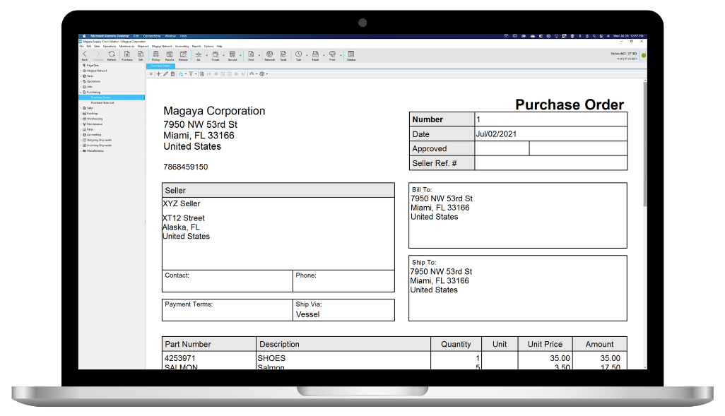
MAGAYA SUPPLY CHAIN Imports

Slide 8
MAGAYA SUPPLY CHAIN Imports
Accelerate import shipping workflows and save time on manual processes with Magaya. You can also avoid double data entry by creating bookings, pickup orders, warehouse receipts, shipments, and invoices, directly from the quotes feature.
YOUR BENEFITS
Streamline, automate, and optimize the Purchase Order process, ensuring that you start the import process on the right foot
Seamless workflows dedicated to transfer all important documents and processes for your import tasks
Streamline operations with all data stored in a single system, allowing for up-to-date information on all tasks
BOOKINGS & SHIPMENTS
Create bookings or shipments for export, import, or domestic transactions.
Access workflows for air, ocean, or ground shipments.
Manage consolidations, LCL, FCL.
Handle inbound shipments, including on-hand cargo directly into warehouse receipts for storage, release, cross-docking, or last-mile delivery.
Accept online booking requests from your customers via the LiveTrack Mobile App by Magaya.
Receive booking requests and shipping instructions via INTTRA.
Track all your containers with the Container Tracking extension, receiving updates through events in your Magaya system, Magaya Digital Freight Portal and LiveTrack Mobile App.
Get cargo insurance directly on the shipment in Magaya.
Create shipments and print labels with FedEx, UPS, USPS directly from the system.
Take advantage of hundreds of industry-standard shipping document templates.
Liquidate shipments (create accounting transactions) for entire consolidations with one click.
FREIGHT QUOTES
Magaya Rate Management integration makes it easy to create bookings, pickup orders, warehouse receipts, shipments, invoices from quotes.
Leverage the best air cargo rates in the market within a single system to supercharge your quoting and procurement process.
Stay up to date with real-time status and event updates directly from within the events tab of your Magaya Supply Chain booking or shipment.
PO MANAGEMENT
Automate replenishment based on Safety Stock and seasonality.
Calculate the average cost and landed cost, and control backorder management.
Manage your POs via EDI into inbound shipments in your Magaya system either fully or partially.
Send your shipments to final destination, cross-docking, or received in your warehouse.
Provide reports to your customer on a line-item level status of the PO.
PICK-UP ORDER MANAGEMENT
Facilitate local pickups or drayage.
Send pickup tasks to drivers, capture pictures and signatures, via the Final Mile app.
ACCOUNTING
Integrated Operations and Accounting
Liquidate operations (create accounting transactions) with one click.
Invoices and bills stay linked to operations and display reference info.
View profit and loss by operation.
Accounting integration with the QuickBooks Online extension
Online Payments
Receive online payments via First Data and Veem

Slide 9
MAGAYA SUPPLY CHAIN APPS & EXTENSIONS Imports
With direct connections to U.S. CBP via Magaya Customs Compliance, an ACE-certified ABI solution, Magaya Supply Chain streamlines your import processes by giving you the ability to file all your important customs documentation all within a single system of record.
YOUR BENEFITS
Eliminate double data entry and stay in compliance with U.S. customs integrations
Navigate customs and trade requirements quickly and easily, all from a single platform
Streamline operations with all data stored in a single system, allowing for up-to-date information on all tasks
AMS QUERY
Streamline and simplify the access to your manifest information of your Bill of Lading or Air Waybill, directly from your Magaya system.
Quickly access crucial information for your import operations.
Understand the correct manifested information in order to match each subsequent filing.
DENIED PARTY SCREENING
Scan your shipments, entities, countries, vessels against restricted party databases to avoid liability.
VIN DECODER
Avoid mistakes and increase efficiency by entering or scanning the VIN which populates data such as year, make, and model.
Allow your customer to use VIN decoder when sending an online pickup request.
ISF
For importers, Magaya ISF (Importer Security Filing) facilitates sending information to U.S. Customs and Border Protection (CBP) before the cargo is brought into the U.S. by vessel.
AUTOMATED MANIFEST SYSTEM (AMS) AIR & OCEAN
Comply with Customs’ 24-hour manifest regulation by sending your shipment data to Customs from your Magaya system.
Submit the required U.S. Customs information such as the Air Waybill for air import shipments before the shipment arrives in the United States.
CARGO INSURANCE
Easily process insurance requests by generating and saving declarations As well as issuing a certificate of insurance directly from the shipment.
CONTAINER TRACKING
Track your containers worldwide across more than 100 sealines with just one click all within your Magaya Supply Chain system, eliminating wasted time and manual processes.
Easily share your tracked containers’ status updates as events in the Magaya Digital Freight Portal or LiveTrack Mobile App by Magaya for full self-serve, 24/7 visibility for your clients.
PICKUP-DELIVERY ORDERS
Manage your pickup and delivery charges
Maintain delivery visibility with the Final Mile app for drivers. Proof of delivery date, time and electronic signatures are captured in real-time.
Integrate with FEDEX/UPS/USPS, and manage rates, tracking numbers, labels and real- time status updates.

Slide 10
MAGAYA SUPPLY CHAIN Warehousing for Import Operations
Optimize warehouse and distribution operations, manage sales orders, track inventory, and oversee the aspects of the supply chain that happen before and after the warehouse.
YOUR BENEFITS
Turbocharge your receiving operations with cutting-edge warehouse automation solutions that save you time and money
Optimize your warehouse operations by mapping out arrival locations, plus facilitating put away and picking, with a directed operations sequence
Gain greater accuracy and visibility with a suite of integrated solutions designed to work with your Magaya Supply Chain system
WAREHOUSE RECEIPTS
Process on-hand cargo directly from quotes, bookings, pickup orders or inbound shipments.
Leverage seamless workflows between warehousing and shipping which enables cargo to be loaded directly onto outbound shipment.
SALES ORDER MANAGEMENT
Create sales orders from commerce quotes.
Manage and create automated allocation rules.
Create pricing rules and minimum price protection.
WAREHOUSE OPERATIONS
Access arrival and location of cargo, SKUs, serial numbers, lot numbers, and multiple stores.
Manage your workday more efficiently with insights into real-time inventory, orders, and more.
SMART WAREHOUSE
Manage inventory by part numbers, serial numbers, lot numbers, expiration dates.
Access inventory queue types supported: FIFO, LIFO, FEFO, LEFO.
Direct the operators to the right locations in the warehouse using pick and put-away sequences.
Operate automatic replenishment with ease, from storage to pick locations.
Manage multiple warehouses in one database.
Manage on-hand cargo directly from quotes, bookings, pickup orders or inbound shipments.
Keep a record of arrival and location of cargo, SKU’s, serial numbers, lot numbers, and expiration date.
Define locations for receiving, storage, quality control, holding area, replenishments, etc.
MAGAYA SUPPLY CHAIN APPS & EXTENSIONS FOR WAREHOUSE MANAGEMENT
PHOTOS WITH BINDER APP
Use your phone or tablet to capture and instantly upload photos of your parcels, cargo and more.
Easily find transactions or items by manual search or scanning a barcode.
Keep accurate records when processing warehouse receipts and shipments by attaching photos to the transaction.
FLOW WMS MOBILE APP
Take complete control of your inventory, tasks, receiving and shipping process in real time with the Flow WMS app.
Integrates with Dimensioner to truly optimize the receiving process.
PALLET AND PARCEL DIMENSIONER
Take fast and efficient measurements of pallets or parcels with sophisticated software algorithms, regardless of shape, size or material.

Slide 11
MAGAYA SUPPLY CHAIN Accounting
Keep your operations and accounting synced on one platform and automate your workflows, including recurring billing and periodic invoices. Manage accounts receivable and accounts payable with ease and generate reports, providing clear insight into the financial health of your business.
YOUR BENEFITS
Transfer your information between all your logistics transactions to create the necessary accounting records
Generate reports that provide you with the exact information you need
Work with multiple currencies
INTEGRATED OPERATIONS AND ACCOUNTING
Liquidate operations (create accounting transactions) with one click.
Maintain visibility as invoices and bills stay linked to operations and display reference info.
View Profit and Loss by Operation.
Assign role-based permissions to employees for greater flexibility, security, and control.
ONLINE PAYMENTS
Receive online payments via First Data and Veem.
ACCOUNTING TRANSACTIONS
Leverage integrated accounting functionality:
General Ledger
AR and AP with aging reports Profit and Loss reports
Full suite of financial reports
Customer and Vendor Payments
Bank reconciliation and fiscal year closing Multicurrency accounting
Automated recurring billing and periodic invoices
QUICKBOOKS ONLINE EXTENSION
Connect your Magaya system to your QuickBooks Online account.
Sync your Magaya invoices, credit memos, bills, and bill credits between both systems.
Ensure data is consistent across platforms as information flows freely between Magaya and QuickBooks Online.

Slide 12
MAGAYA SUPPLY CHAIN Productivity, Integration & Configuration
Leverage the branding of your business with our flexible options, including document templates and more. Our ecosystem of extensions and apps, coupled with our built-in features, are designed to make your business more productive.
YOUR BENEFITS
Personalize your documents by using our adaptable templates
Leverage complex logic
Choose from a variety of connectivity options, including XML and EDI
JOBS
Combine many transactions of different types into one project with its respective accounting and profitability tracking. Ideal for project cargo in shipping.
TASKS
Create reminders by email or on-screen popups.
Assign tasks to any user in the system.
Visibility into employee time to complete tasks.
MAGAYA NETWORK
Send and receive documentation, transactions, and other data about shipments, through the Magaya Network.
View real-time, up-to-date information about shipments and more.
Create a profile of your company to advertise your services on the Network.
Find and connect with 2300+ agents and logistics companies across 100 countries.
DOCUMENT CONFIGURATION
Access and utilize hundreds of document templates for operations and accounting transaction.
Create and design multipage templates including your terms and conditions.
Fully configure documents and even use JavaScript for more complex logic.

Slide 13
MAGAYA SUPPLY CHAIN Exports

Slide 14
MAGAYA SUPPLY CHAIN Exports
Accelerate export shipping workflows and save time on manual processes with Magaya. You can also avoid double data entry by creating bookings, pickup orders, warehouse receipts, shipments, and invoices, directly from the quotes feature.
YOUR BENEFITS
Leverage visibility and automation needed to compete in today’s competitive global shipping market
Have seamless workflows dedicated to transfer all important documents and processes for your export tasks
Streamline operations with all data stored in a single system, allowing for up-to-date information on all tasks
BOOKINGS & SHIPMENTS
Create bookings or shipments for export, import, or domestic transactions.
Access workflows for air, ocean, or ground shipments.
Manage consolidations, LCL, FCL.
Accept online booking requests from your customers via the Magaya Digital Freight Porta or LiveTrack Mobile App by Magaya.
Send ocean booking requests and shipping instructions to carriers via INTTRA and send electronic AWB to the airlines.
Track all your containers with the Container Tracking extension, receiving updates through events in your Magaya system, Magaya Digital Freight Portal and LiveTrack Mobile App.
Get cargo insurance directly on the shipment in Magaya.
Liquidate shipments (create accounting transactions) for entire consolidations with one click.
Create shipments and print labels with FedEx, UPS, USPS directly from the system.
Take advantage of hundreds of industry-standard shipping document templates.
Shipment Transfer and Receipt in Destination Database via Magaya Network (if destination Agent has Magaya)
ACCOUNTING
Integrated Operations and Accounting
Invoices and bills stay linked to operations and display reference info.
View profit and loss by operation.
Accounting integration with the QuickBooks Online extension
Online Payments
Receive online payments via First Data and Veem
PICK-UP ORDER MANAGEMENT
Facilitate local pickups or drayage.
Send pickup tasks to drivers, capture pictures and signatures, via the Final Mile app.
FREIGHT QUOTES
Magaya Rate Management integration makes it easy to create bookings, pickup orders, warehouse receipts, shipments, invoices from quotes.
Leverage the best air cargo rates in the market within a single system to supercharge your quoting and procurement process.
Stay up to date with real-time status and event updates directly from within the events tab of your Magaya Supply Chain booking or shipment.
PO MANAGEMENT
Automate replenishment based on Safety Stock and seasonality.
Calculate the average cost and landed cost, and control backorder management.
Manage your POs via EDI into inbound shipments in your Magaya system either fully or partially.
Send your shipments to final destination, cross-docking, or received in your warehouse.
Provide reports to your customer on a line item level status of the PO.

Slide 15
MAGAYA SUPPLY CHAIN APPS & EXTENSIONS Exports
Accelerate export shipping workflows and save time on manual processes with Magaya. You can also avoid double data entry by creating bookings, pickup orders, warehouse receipts, shipments, and invoices, directly from the quotes feature.
YOUR BENEFITS
Monitor the different stages of the logistics and transportation process, including details of the status changes of your containers
Navigate customs and trade requirements quickly and easily, all from a single platform
Have seamless workflows dedicated to transfer all important documents and processes for your export tasks
DENIED PARTY SCREENING
Scan your shipments, entities, countries, vessels against restricted party databases to avoid liability. AUTOMATED COMMERCIAL ENVIRONMENT (ACE) OR (AES)
Send the Electronic Export Information (EEI), formerly called the Shipper’s Export Declaration (SED), to the U.S. Customs ACE portal and receive confirmation back into your Magaya system.
Comply with U.S. Customs filing requirements stating that your export shipment documentation must be sent electronically to U.S. Customs if the value of the cargo is greater than $2,500.
VIN DECODER
Avoid mistakes and increase efficiency by entering or scanning the VIN which populates data such as year, make, and model.
COURIER SHIPPING
The Courier Connections extension gives you complete, end-to-end shipping order management including label printing and shipment tracking with connections to DHL, USPS, FedEx, UPS, and so many more.
INTTRA
The INTTRA and Magaya connection provides the opportunity to send bookings to ocean carriers and receive shipping instructions directly from Magaya Supply Chain.
CARGO INSURANCE
Easily process insurance requests by generating and saving declarations As well as issuing a certificate of insurance directly from the shipment.
CONTAINER TRACKING
Track your containers worldwide across more than 100 sealines with just one click all within your Magaya Supply Chain system, eliminating wasted time and manual processes.
Easily share your tracked containers’ status updates as events in the Magaya Digital Freight Portal or LiveTrack Mobile App by Magaya for full self-serve, 24/7 visibility for your clients.
ELECTRONIC AIR WAYBILL (EAWB)
Access connections to 100+ airlines and communicate electronically between airlines and logistics providers such as freight forwarders.
Send AWB data from your Magaya system to the airline and receive confirmation directly into your Magaya system.

Slide 16
MAGAYA SUPPLY CHAIN Warehousing for Export Operations
Optimize warehouse and distribution operations, manage sales orders, track inventory, and oversee the aspects of the supply chain that happen before and after the warehouse.
YOUR BENEFITS
Enable seamless workflows between warehousing and shipping, allowing cargo to be loaded directly to outbound shipments
Optimize your warehouse productivity, enabling you to run a profitable warehouse without the expense of a third-party WMS solution
Easily send tracking numbers and inventory updates to the online sales channel the moment you ship the order
WAREHOUSE RECEIPTS
Process on-hand cargo directly from quotes, bookings, pickup orders or inbound shipments.
Leverage seamless workflows between warehousing and shipping which enables cargo to be loaded directly onto outbound shipment.
SALES ORDER MANAGEMENT
Create Sales Orders from Commerce Quotes.
Manage and create automated allocation rules.
Create pricing rules and minimum price protection.
WAREHOUSE OPERATIONS
Access arrival and location of cargo, SKUs, serial numbers, lot numbers, and multiple stores.
Manage your workday more efficiently with insights into real-time inventory, orders, and more.
SMART WAREHOUSE
Manage inventory by part numbers, serial numbers, lot numbers, expiration dates.
Access inventory queue types supported: FIFO, LIFO, FEFO, LEFO.
Direct the operators to the right locations in the warehouse using pick and put-away sequences.
Operate automatic replenishment with ease, from storage to pick locations.
Manage multiple warehouses in one database.
Manage on-hand cargo directly from quotes, bookings, pickup orders or inbound shipments.
Keep a record of arrival and location of cargo, SKU’s, serial numbers, lot numbers, and expiration date.
Define locations for receiving, storage, quality control, holding area, replenishments, etc.
MAGAYA SUPPLY CHAIN APPS & EXTENSIONS FOR WAREHOUSE MANAGEMENT
FLOW WMS MOBILE APP
Take complete control of your inventory, tasks, receiving and shipping process in real time with the Flow WMS app.
Integrates with Dimensioner to truly optimize the pick and pack process.
PALLET AND PAREL DIMENSIONER
Take fast and efficient measurements of pallets or parcels, regardless of shape, size or material with sophisticated software algorithms.

Slide 17
MAGAYA SUPPLY CHAIN Accounting
Keep your operations and accounting synced on one platform and automate your workflows, including recurring billing and periodic invoices. Manage accounts receivable and accounts payable with ease, as well as generate reports, providing clear insight into the financial health of your business.
YOUR BENEFITS
Transfer your information between all your logistics transactions to create the necessary accounting records
Generate reports that provide you with the exact information you need
Work with multiple currencies
INTEGRATED OPERATIONS AND ACCOUNTING
Liquidate operations (create accounting transactions) with one click.
Maintain visibility as invoices and bills stay linked to operations and display reference info.
View Profit and Loss by Operation.
Assign role-based permissions to employees for greater flexibility, security, and control.
ONLINE PAYMENTS
Receive online payments via First Data and Veem.
ACCOUNTING TRANSACTIONS
Leverage integrated accounting functionality:
General Ledger
AR and AP with aging reports Profit and Loss reports
Full suite of financial reports
Customer and Vendor Payments
Bank reconciliation and fiscal year closing Multicurrency accounting
Automated recurring billing and periodic invoices
QUICKBOOKS ONLINE EXTENSION
Connect your Magaya system to your QuickBooks Online account.
Sync your Magaya invoices, credit memos, bills, and bill credits between both systems.
Ensure data is consistent across platforms as information flows freely between Magaya and QuickBooks Online.

Slide 18
MAGAYA SUPPLY CHAIN Productivity, Integration & Configuration
Leverage the branding of your business with our configuration options, including document templates, and more. Our ecosystem of extensions and apps, coupled with our built-in features, are designed to make your business more productive.
YOUR BENEFITS
Personalize your documents by using our configurable templates
Leverage complex logic
Choose from a variety of connectivity options, including XML and EDI
JOBS
Combine many transactions of different types into one project with its respective accounting and profitability tracking. Ideal for project cargo in shipping.
TASKS
Create reminders by email or on-screen popups.
Assign tasks to any user in the system.
Visibility into employee time to complete tasks.
MAGAYA NETWORK
Send and receive documentation, transactions, and other data about shipments, through the Magaya Network.
View real-time, up-to-date information about shipments and more.
Create a profile of your company to advertise your services on the Network.
Find and connect with 2300+ agents and logistics companies across 100 countries.
DOCUMENT CONFIGURATION
Access and utilize hundreds of document templates for operations and accounting transaction.
Create and design multipage templates including your terms and conditions.
Fully configure documents and even use JavaScript for more complex logic.

Slide 19
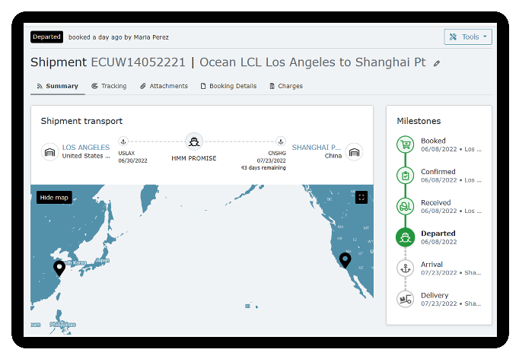
MAGAYA DIGITAL FREIGHT PORTAL
Get quickly established as a digital freight forwarder with the Magaya Digital Freight Portal, a completely branded customer-facing portal for your business. Your customers will love the added visibility and control they get with easy self-service access to quotes, schedules, bookings, shipments, tracking, and reporting.
BENEFITS
BOOSTS PRODUCTIVITY
Automate many of the repetitive tasks related to the sales cycle, freeing your team’s time to generate new business and work on strategic growth initiatives.
MODERNIZES THE CUSTOMER EXPERIENCE
Provide your customers with an immersive digital experience from quote to booking and beyond, complete with full tracking visibility and reporting all from a custom-branded digital portal.
ALLOWS FLEXIBILITY
Direct integration with the entire Magaya Digital Freight Platform ensures a single source of the truth while automating and digitizing your business. Plus, its flexible API allows you to also connect it to the ERP/TMS system of your choice.
STREAMLINES RATE MANAGEMENT
Manage and analyze your global buying tariffs, pull direct carrier integrations for contract and spot rates, view and apply surcharges, free time, future GRIs and more with seamless integration with Magaya Rate Management.
STRENGTHENS YOUR BRAND PRESENCE
Gain complete control over your branding with a white-labeled portal. From colors to media and content, we give you the tools to fully leverage your brand, complete with single sign-on.
KEY FEATURES
WHITE LABEL, CUSTOMER-FACING PORTAL
Quoting
Schedules
Booking
Visibility
Collaboration Tools
Reporting
Invoices & Payments
Warehouse Receipts*
Cargo Releases*
Inventory Reports*
Pick Up Orders*
Cargo Detail*
ADMINISTRATION AND FORWARDER FEATURES
Customer and User Management
Schedules Management
Shipment and RFQ
Margin Management
*Only available through direct integration with Magaya Supply Chain.

Slide 20
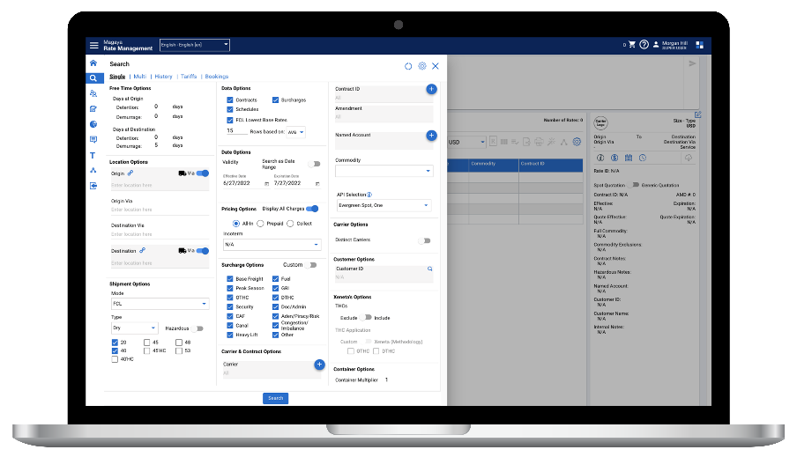
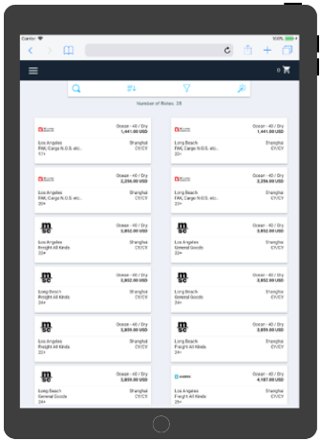
MAGAYA RATE MANAGEMENT
Simplify complex data and manage margins from a central control tower. Magaya Rate Management is technology built around the specific rating and quoting needs of freight forwarders, NVOCCs, and carriers.
BENEFITS
INDUSTRY-SPECIFIC
Critical information and data points are organized in a practical way that is intuitive, detailed, and configurable, based on our wealth of expertise in the freight forwarding industry and an in-house team.
CREATE ALIGNMENT
Find and compare all rates, schedules, and free time in one place, ensuring efficiency and visibility for your customers.
SCALABLE ENTERPRISE SOLUTION
Flexible setup options for organizations of all sizes, with branded client-facing portal capability and extensive integration options.
OPTIMIZE PROCESSES
Built-in controls allow administrators management over rate visibility and pricing authorities, ensuring the right rates are displayed to the right employees.
KEY FEATURES
Ocean/air/ground rates in one system
Competitive air freight rates from 95 airlines
Rate prioritization and surcharge grouping
Surcharge Manager and FMC Filing modules
Flexible integration options for TMS and 3rd party software
Tender and RFQ response software
Reports and analytics from rate trends to quote success and more
Create, configure, and send multi-modal quotes faster
Freight Allocation and Incentive Management
Secure, FMC-compliant NRA document repository

Slide 21
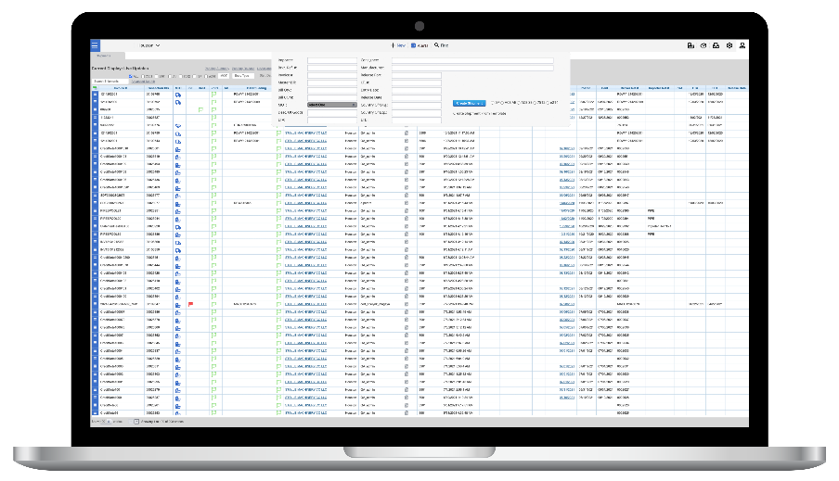
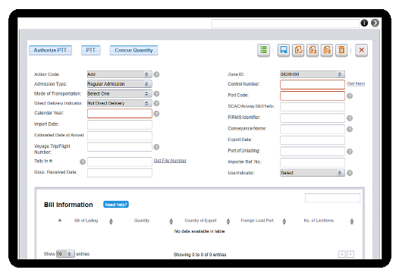
MAGAYA CUSTOMS COMPLIANCE
A cloud-based ACE-certified ABI solution focused on compliance and efficiency. Magaya Customs Compliance offers you out of the box real-time API/EDI capability that enables companies to integrate their in-house applications with U.S. CBP.
BENEFITS
ACE-CERTIFIED PORTAL
ACE-certified ABI solution focused on compliance and efficiency, with full filing capabilities.
DIRECT U.S. CUSTOMS CONNECTION
Near non-existent downtime and a smooth, uninterrupted, connection to ACE thanks to the use of Multiple Data Centers to host our data.
CLOUD PLATFORM
We host and manage our platform in a highly secure, fully redundant cloud platform that meets all ISO and security standards.
AUTOMATIONS
Automations built to increase efficiency, eliminate redundancies, and avoid data errors when filing key documents.
ACE FILING MODULES
3461 & 7501 (ACE SE & ACE AE)
Type 86 Mass Upload
Air Manifest for Section 321
FDA/PN and all active PGA forms
ISF
FTZ (e214)
AES (Export)
Truck eManifest
Reconciliation
Duty Drawback
Query Module for: AIR AMS, Ocean AMS, Bond, Tariff, FIRMS, SCAC, ADD/CVD and Quota

Slide 22
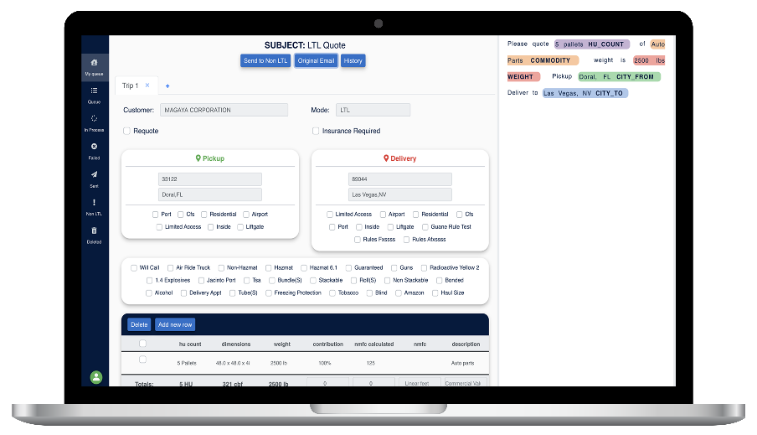
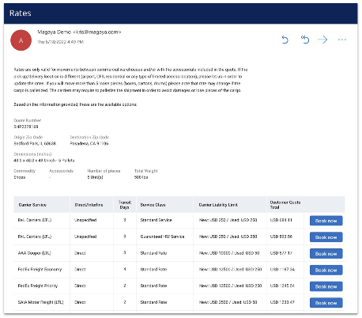
QUOTE AUTOMATION
BY MAGAYA
Leverage the power of AI to transform the way you quote inland freight with Quote Automation by Magaya. Receive quote requests, gather rates from multiple carriers, and bring everything back into an email in an instant. Plus, enjoy access to the best LTL and FTL rates on the market all in an easy-to-use, simple interface.
BENEFITS
SAVE TIME
Save 15 minutes on average PER QUOTE by automating the process of receiving quote requests, gathering rates, adding markups, and returning the quote with Quote Automation.
ACCESS LOWER RATES
With built-in access to all major carriers, we’ve negotiated the lowest inland freight rates on the market, saving you and your customers money.
EASY TO USE
You’ll be amazed at how something that used to take dozens of steps, phone calls, emails, and browser tabs, can now be done in just a few clicks in the intuitive, simple user interface. Plus, no NMFC class or shipping class required for quoting.
BOOST PRODUCTIVITY
With significantly less time required for quoting, your employees can work on additional tasks, accomplishing more per day.
BUILDING AND SENDING QUOTES IS AS EASY AS 1-2-3
YOUR CUSTOMER REQUESTS A QUOTE
Your customer calls in or emails their quote request, just as they always have. They don’t require any specialized software on their end.
YOU REVIEW & ACCEPT THE REQUEST
Review the request in your Quote Automation portal, adding your markup and making any edits needed. Receive rates from all major carriers in an instant, right inside the application!
YOUR QUOTE IS READY
Just one more click, and your quote is ready to be emailed back to the customer.

Slide 23
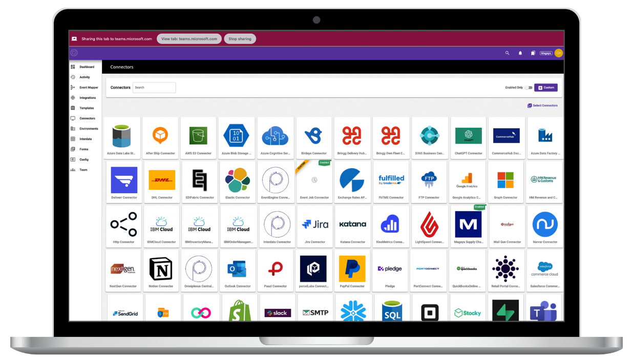
MAGAYA CONNECT
Create your ideal connected supply chain with efficient and reliable interactions between all your apps, data, and people.
Quickly and easily connect any system to the Magaya Digital Freight Platform, including:
Shipping & logistics
Accounting & payment processing
Customs compliance & government
Analytics
E-commerce
ERP & business applications
Cloud storage & data management
Collaboration & communication
https://www.magaya.com/magaya-connect/

Slide 24
DIMENSIONER BY MAGAYA
Automates a slow, manual process
Captures accurate cargo dimensions with ease, in under 5 seconds
Eliminates upfront costs of traditional measuring tools
Available for pallet, parcel, and high-volume in-motion dimensioning
20%
$40
INCREASE IN REVENUE
EVERY MONTH
ON AVERAGE OF REVENUE
RECOUPED PER PALLET

Slide 25
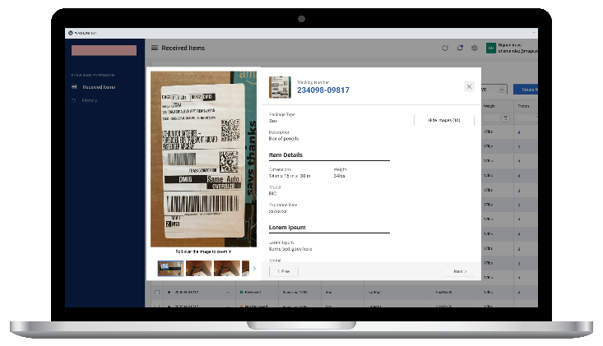
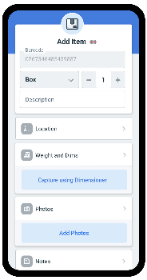
MAGAYA SUPPLY CHAIN APPS & EXTENSIONS
FLOW WMS
BY MAGAYA
Designed for Android™ and iOS™, Flow WMS gives you the freedom of a modern mobile WMS with the real-time visibility and functionality you need for efficient and fast receiving and warehouse operations. With complete control of your warehouse tasks, Flow WMS goes beyond basic warehouse inventory control giving you true productivity in the warehouse.
BENEFITS
INTEGRATED
Flow WMS is designed to work in perfect harmony with Magaya Supply Chain and Magaya Dimensioner, giving you the perfect toolset for your most efficient warehouse ever.
REAL-TIME
Scan barcodes and take photos with the Flow WMS app and attach them in real-time to the related transaction in your Magaya system.
INTUITIVE
Leave clunky old mobile WMS tools in the past, where they belong! Flow WMS has a modern, intuitive interface your users will love, encouraging fast adoption and frequent use.
WORKS WITHOUT WI-FI
Warehouses are notorious for having wi-fi dead zones. Flow WMS keeps you up and running with mobile data - even in the event the wi-fi connection drops.
PHOTO CAPTURE
Document your inventory with photos from the device’s built-in camera. Capture high-quality photos and scan barcodes, then upload them in real-time to the related item or commodity in your Magaya system.
KEY FEATURES
RECEIVING
Blind or by reference
Quick receiving or full details
Scan or manually enter items
Capture photos, print labels, repack
Obtain weights and measures from Dimensioner by Magaya
LOOKUP
Find and edit items by tracking number or location
Take additional photos as needed
Assign new locations
Reprint labels
Obtain weights and measures from Dimensioner by Magaya
View and edit item data
SPECIFICATIONS
In-progress operations saved on the device
Progress can be saved before submitting
Works over wi-fi or mobile data
Compatible with Android (6 and newer) and iPhone (11 and newer)
PICKING & LOADING
Take pictures and edit item information during pick and load
Repack at any time and select package type
Delegate or reassign tasks to other users
Load items directly into a shipping container

Slide 26
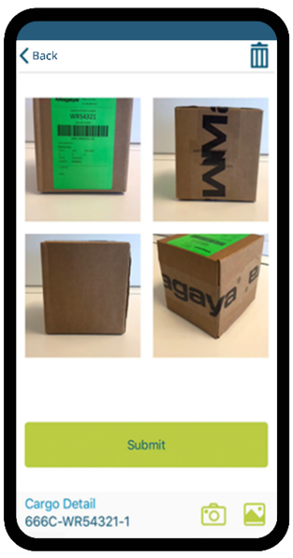
MAGAYA SUPPLY CHAIN APPS & EXTENSIONS
BINDER
BY MAGAYA
The Binder app takes photos of packages or cargo, barcode labels, documents, PDFs, checks, and more, and it then instantly attaches the photos to existing Magaya transactions or commodities in the system. It is often used in the warehouse to take photos of cargo and add them to Warehouse Receipts, Shipments, or other Magaya Supply Chain transactions.
BENEFITS
ADAPTS TO YOUR WORKFLOW
Add images to your Magaya Supply Chain transactions directly from the Binder app. Binder also lets you easily find the transaction or item in Magaya Supply Chain by manually searching or scanning a barcode.
DELIVERS A BETTER CUSTOMER EXPERIENCE
Take pictures of items or documents and send them directly to the right transaction in Magaya, providing the visibility customers want. Pictures are visible to the customer in real-time via the Magaya Digital Freight Portal and LiveTrack Mobile App by Magaya.
SAVES TIME AND MONEY
Save several minutes per item compared to using cameras, cables, memory cards. Plugging camera cables or memory cards is a huge time waster, and sensitive equipment is not made to withstand the warehouse environment.
EASY TO USE
Download the free app to an iOS or Android device and begin uploading photos to the system. There is no setup needed to get started with Binder!
KEY FEATURES
Easy to use on your existing Android or iOS mobile devices.
Take photos or add existing ones that are saved in your phone’s gallery.
Use cellular data or Wi-Fi to upload photos.
Add a Photo to an existing Magaya Transaction.
Add photos to items that you load into a shipment “on-the-fly” Even if the item is not in your Commodity List yet.
“Binder by Magaya has helped us immensely in terms of automating the process of vehicle arrival. We can scan a warehouse receipt and attach all the photos with the Binder app directly into our Magaya system. Before we would have to go through a long process of taking pictures and trying to attach the pictures to the respective transactions. What used to take about 20 minutes now only a couple of minutes with Binder.”
▬
Dmitriy Shibarshin
Marketing Director | West Coast Shipping

Slide 27
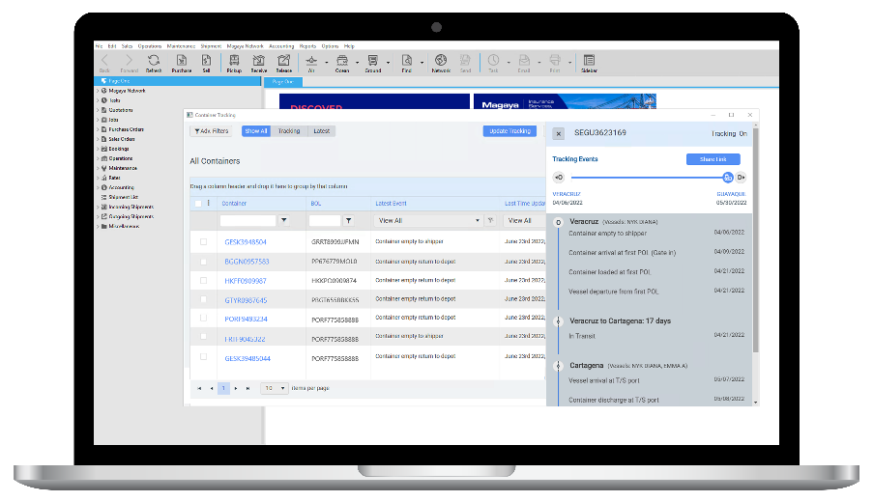
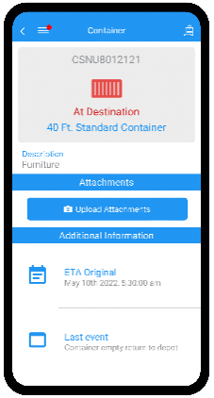
MAGAYA SUPPLY CHAIN APPS & EXTENSIONS
CONTAINER TRACKING
BY MAGAYA
Save time and accelerate your tracking workflows with just one click to track all your containers worldwide. Track your ocean shipment containers across more than 100 sealines faster and more efficiently than ever, all within Magaya Supply Chain.
The solution enables global monitoring of your ocean container numbers, delivering better control and freight management as your shipments move from origin to destination.
BENEFITS
IMPROVES VISIBILITY FOR ALL STAKEHOLDERS
No matter where your containers are around the world, Container Tracking gives you direct visibility of your containers within Magaya Supply Chain.
INTEGRATES WITH THE MAGAYA DIGITAL FREIGHT PORTAL AND LIVETRACK MOBILE APP BY MAGAYA
Easily share your tracked containers’ status updates as events in the Digital Freight Portal or LiveTrack app, giving your customers 24/7, self-serve access.
SAVES TIME AND ELIMINATES MANUAL PROCESSES
The Container Tracking extension saves you time by linking container information in your shipments to container tracking sources worldwide, giving you quick access to the status of your containers.
KEY FEATURES
ONE-CLICK TRACKING
Track by container or Bill of Lading number
Search using SCAC code for best results
Track containers in batch
Easily search containers in the grid
UPDATED ANYTIME WITH EVENTS
New event definitions are auto-created
Events messages grouped by containers
Daily auto-updates
SHARE EASILY WITH THE MAGAYA DIGITAL FREIGHT PORTAL AND LIVETRACK MOBILE APP BY MAGAYA
Configure events to trigger milestones in the Magaya Digital Freight Portal
Push notifications to the LiveTrack Mobile App

Slide 28
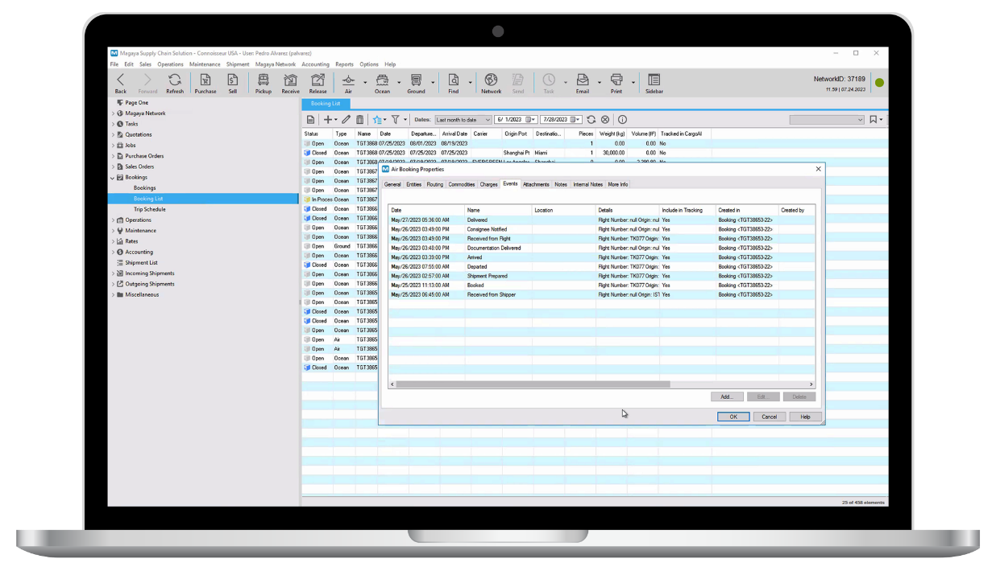
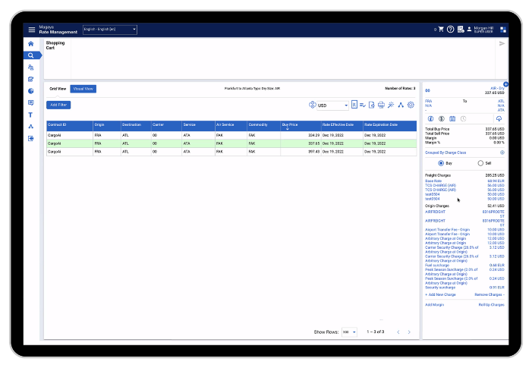
MAGAYA AIR eBOOKING & TRACKING
OVERVIEW
MAGAYA RATE MANAGEMENT & MAGAYA SUPPLY CHAIN
Bring your quoting and procurement process to new heights in efficiency by gaining access to rates from more than 95 major airlines in a single, easy-to-use, cloud-based solution.
Save time and win more business with faster quotes and the most competitive rates
Retrieve and compare schedules, availability and pricing, as well as book air shipments**
Track your air shipment directly from a booking or shipment in Magaya Supply Chain with a Master AWB number
Push bookings created in the Air eBooking portal into Magaya Supply Chain and track them in the events tab of a Magaya Supply Chain booking or shipment.*
*Rates and book API coming soon
** Currently available in Magaya Rate Management only

Slide 29
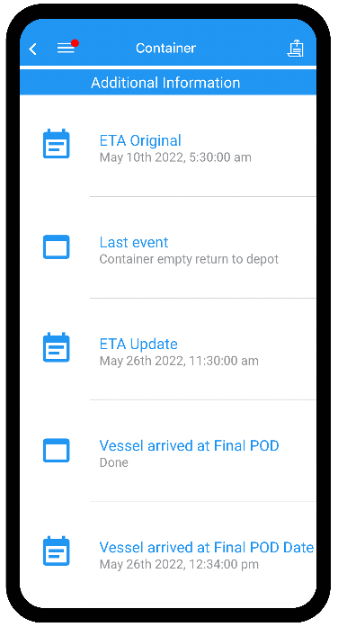
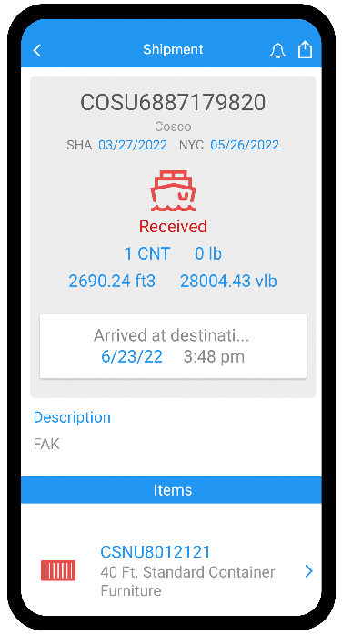
MAGAYA SUPPLY CHAIN APPS & EXTENSIONS
LIVETRACK MOBILE APP
BY MAGAYA
LiveTrack works alongside the Magaya Digital Freight Portal to automate your customer service process by enabling visibility and tracking via a mobile app. Your customers and agents can log into their accounts from any iOS or Android-powered device 24/7, providing them access to warehouse receipts, cargo releases, shipments, purchase orders, invoices, and more. They can also view and share air waybills, bills of lading, and photographs.
BENEFITS
INCREASE VISIBILITY
Enable your customers to see information for a shipment as well as any documents attached to it such as the air waybill, cargo manifest, and more.
NOTIFY CUSTOMERS ON-THE-GO
Provide customers with information on their cargo, inventory quantities, invoices, and more, 24 hours a day.
OPTIMIZE THE CUSTOMER EXPERIENCE
Keep your customers updated on all transactions with self-service functionality, streamlining the manual phone call and email process.
KEEPS DOCUMENTS IN ONE PLACE
Attach documents such as air waybills, bills of lading, photographs, and more to transactions.
Your customers and agents can quickly find their transactions by entering the transaction number or scanning a bar code from their smartphone. Plus, they can receive notifications on the status of their cargo or any inventory related transaction.
“LiveTrack is fantastic to run the business, we use it to push information non-stop to our clients. We have had 150% growth in customer volume over the past 5 years, mainly thanks to LiveTrack. We can handle more volume by putting the responsibility on the client instead of having them call us.”
▬
Carter Gordon
Owner | WP(JA) International

Slide 30
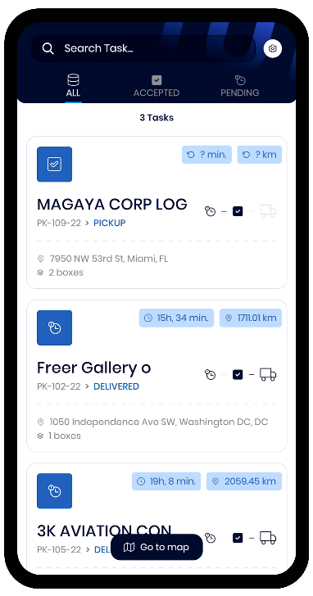
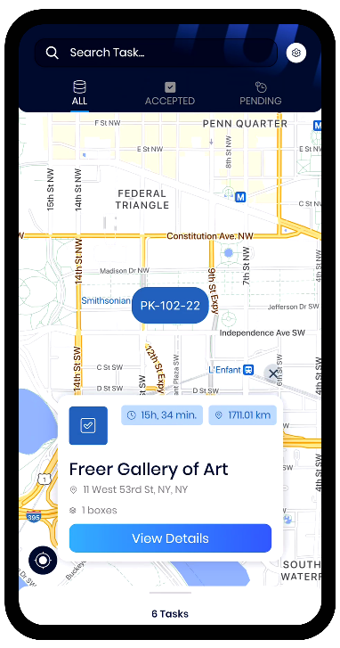

MAGAYA SUPPLY CHAIN APPS & EXTENSIONS
FINAL MILE
BY MAGAYA
The Final Mile app gives drivers an efficient way to pick up and deliver packages and collect signatures, right from their mobile devices. You’ll keep your customers up to date on their delivery status as well as keep your team organized and your Magaya system synced – all from a single app.
BENEFITS
BOOSTS VISIBILITY
Keep customers updated with their pickup and delivery details in real-time, saving you time on customer service calls.
INTEGRATED
Once picked up or delivered, all pertinent data about the delivery is synced back to your Magaya system, automatically.
GO PAPERLESS
Drivers can scan packages and get signatures right on the phone screen, meaning no paperwork to find or carry around.
INCREASES EFFICIENCY
Easily assign tasks to specific drivers or leave them up for grabs. Plus, multiple drivers can use the app to make pickups and deliveries at the same time.
MOBILE COMPATIBILITY
The Final Mile app is free to download on the App Store for iOS or the Google Play Store for Android users.
KEY FEATURES
Use a mobile device or compatible scanner to scan a package barcode
Tasks in Magaya Supply Chain are sent to the app
The app uses the phone’s native maps for turn-by-turn navigation and best route options while on deliveries.
The photo capture feature allows drivers to take photos of packages delivered
Proof of Delivery and photos are visible in the Magaya Digital Freight Portal

Slide 31
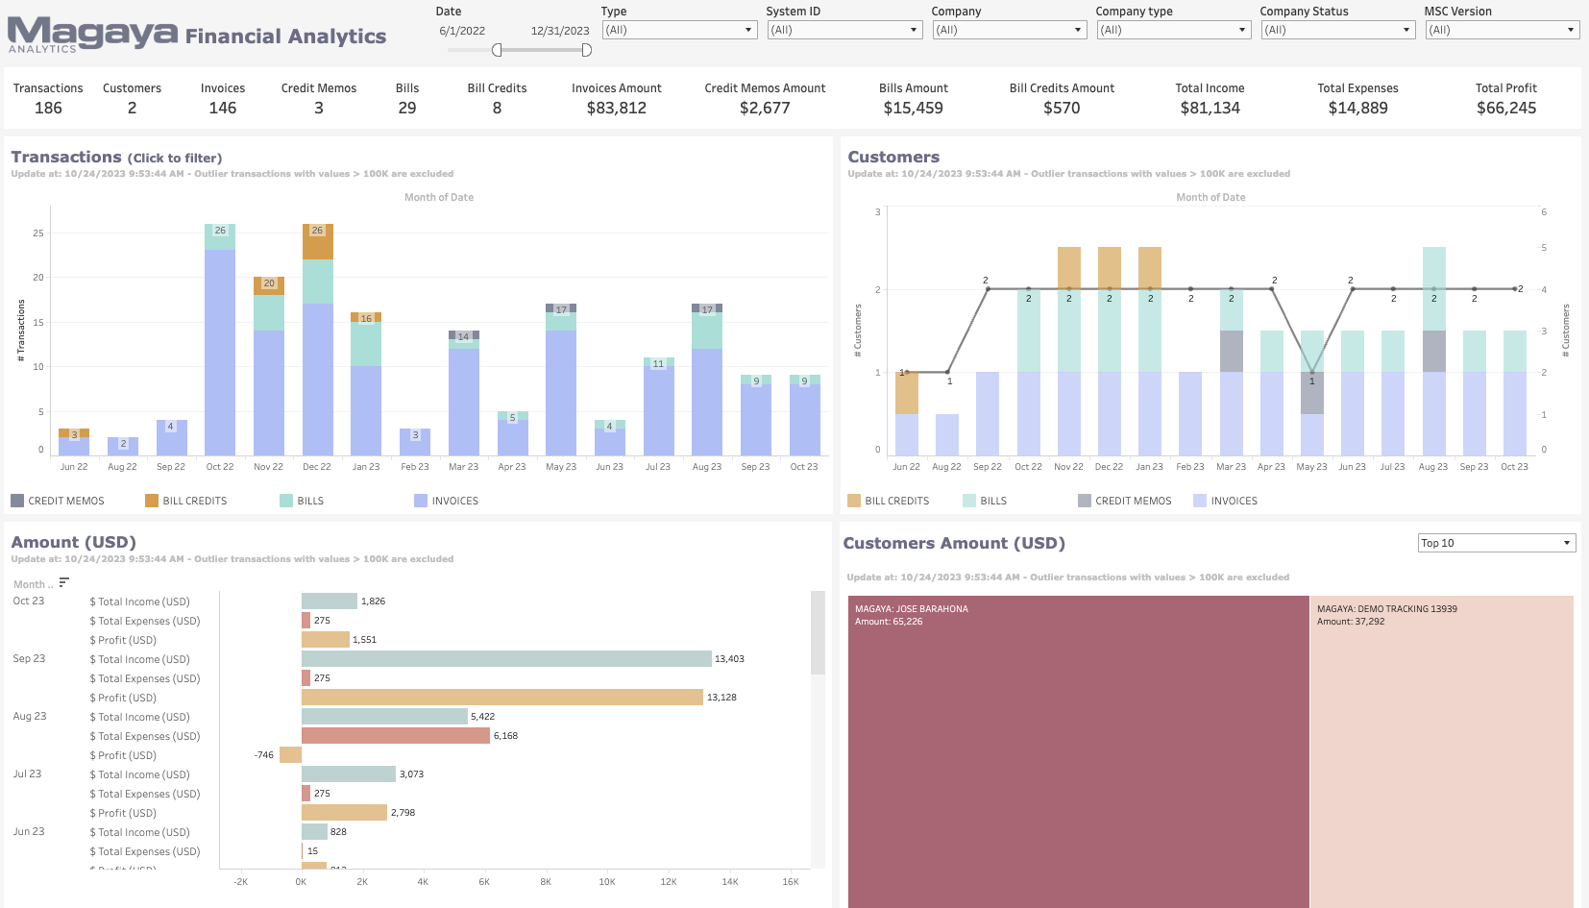
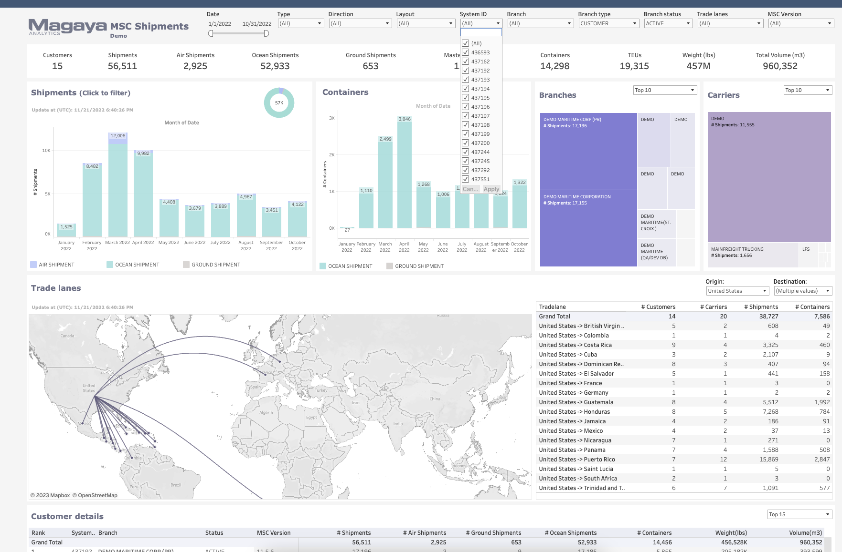
MAGAYA SUPPLY CHAIN APPS & EXTENSIONS
INSIGHTS
BY MAGAYA
With Insights by Magaya, you can spot patterns, make informed decisions, and address your operational challenges head-on. It provides a clear overview of essential data, streamlining the decision-making process.
BENEFITS
ELIMINATES DATA SILOS
Aggregate data from one or multiple Magaya Supply Chain databases into a single data warehouse.
IMPROVES VISIBILITY
With all your data in one place, enjoy the centralized visibility you need to get the full picture of your business. Slice and dice the information to get to the details that truly matter.
ENHANCES DECISION-MAKING
Leverage the information that truly matters for more accurate forecasting and enhanced decision-making based on facts.
DELIVERS FLEXIBLE REPORTING
Utilize a comprehensive report library that segments and highlights key data regarding bookings, shipments, warehouse operations, financials and more.
ENABLES FREEDOM IN THE CLOUD
The solution is hosted in the cloud and is optimized for speed, performance, and data security.
AVAILABLE REPORTS
BOOKINGS AND
SHIPMENTS
Mode of transportation
Containers
TEUs
Shipment Weights
Popular Trade Lanes
Customers
Bookings By Type
WAREHOUSE MANAGEMENT
Warehouse Receipts
Pickup Orders
Cargo Releases
FINANCIALS
Invoices
Credit Memos
Bills
Bill Credits

Slide 32
Eduardo Bencomo
VP Strategic Accounts
ebencomo@magaya.com

